Slide 1
Pairwise Alignments

Slide 2
Learning Objectives
To learn about pairwise alignments and why they are important
To learn how to use dynamic programming to align two sequences

Slide 3
Pairwise Sequence Alignment Algorithms
Today’s problem = Given two sequences (DNA/RNA/Protein), how can we align them such that the matching characters between the two sequences are maximized – pairwise sequence alignment
Sequence S1 = AACGTGTAATCTG
Sequence S2 = TACGATTAAGCTGATAT
AACGTGTAATCTG
TACGATTAAGCTGATAT

Slide 4
The Importance of Pairwise Sequence Alignment
Why is finding optimal pairwise sequence alignments important?
Used to functionally annotate unknown genes
In 1995, The first complete genome of a free-living organism was sequenced, Haemophilus influenzae
Genome contained 1743 predicted genes
Pairwise sequence alignment of predicted genes to genes with known function
Were able to instantly predict the function of 1007 of their 1743 predicted genes
Provided incredible insight into the inner workings of this pathogen

Slide 5
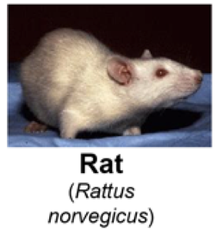
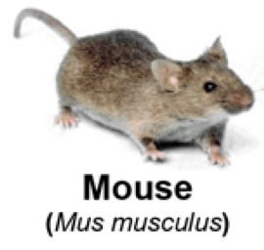
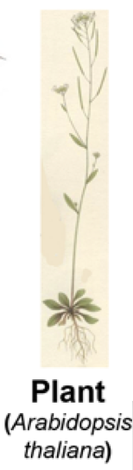

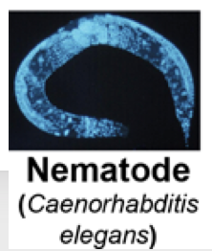
The Importance of Pairwise Sequence Alignment
Used to identify Orthologous Genes
Organisms such as Mouse, Rat, Drosophila etc. are commonly used to identify genes that mediate disease e.g. cancer, diabetes, autism
In order to translate these findings into human therapies, human genes that are the equivalent of model organism genes must be found
Pairwise sequence alignment can identify these equivalent genes which are known as orthologs

Slide 6
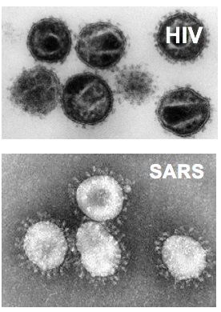
The Importance of Pair-Wise Sequence Alignment
Used in Cases of Disease Outbreak from an unknown pathogen
Every so often a public health crisis arises that is caused by a never before seen pathogen e.g. HIV or SARS
Pairwise sequence alignment can be used to align the novel pathogen’s genome to genomes of known pathogens
Identifying a strong match can inform the biomedical community and guide therapeutic strategies
Also used to answer mundane but important questions e.g. ”Are the primers I’m planning to use for PCR unique to my target gene?”
Many more examples as well.

Slide 7
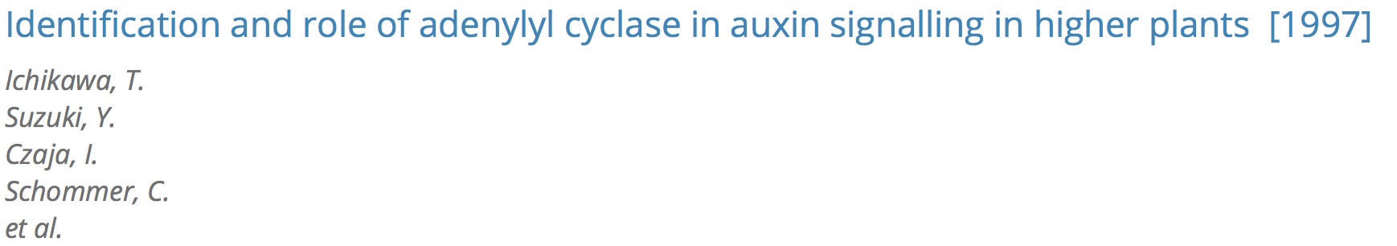
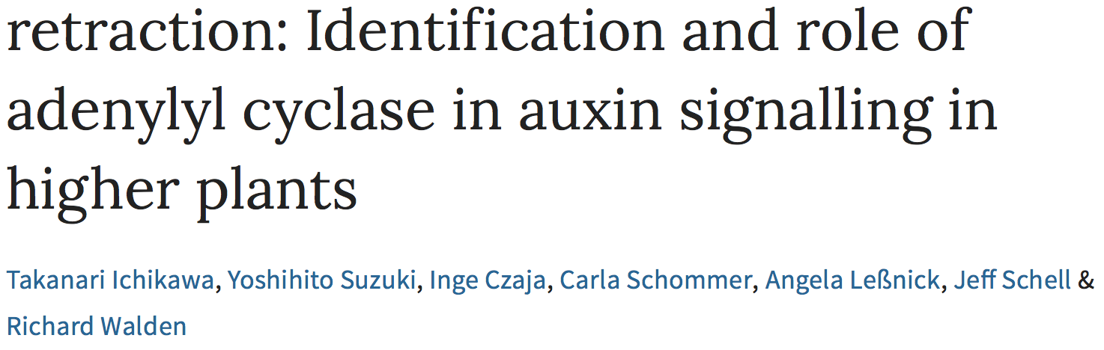
Not only is pairwise sequence alignment important
Getting it wrong can be dangerous:
Used pairwise sequence alignment to identify the first adenylyl cyclase in plants

Slide 8

Brute Force Approach To Pairwise Alignment
What’s the brute force approach? Take two sequences and simply slide them over each other recording the number of matches at each iteration

Slide 9
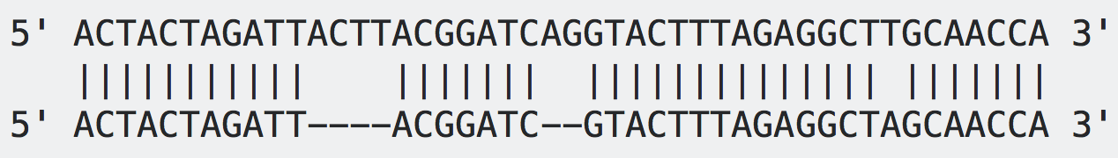
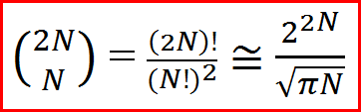
Brute Force Approach Is Not Practical For Gapped Alignments
Brute force approach actually works for ungapped alignments
In most cases however, true optimal alignments include gaps
Pairs of related biological sequences often have insertions or deletions of residues relative to one-another, requires gapped pairwise alignment
To perform a brute force gapped alignment you would have to generate all the possible gap lengths and combinations of gaps at all possible positions in both sequences
Number of possible gapped alignments for two sequences of length N:
N = 10: 184756
N = 50: ~1.00E29
N = 250: ~1.17E149

Slide 10
Alignment Graphs and the Dynamic Programming Algorithm Approach
There is an algorithm that can be used to solve the problem of pairwise sequence alignment
The algorithm that was applied can be illustrated using something called an alignment graphs
What is an alignment graph?
C
T
T
Alignment graphs start out similar to dot plots:
Place sequence S1 horizontally across the top
Place sequence S2 vertically across the side
An alignment graph has nodes (circles) and directed edges (arrows)
A
What does this have to do with alignment?
C
T

Slide 11
Alignment Graphs and the Dynamic Programming Algorithm Approach
Any path we take from node (0,0) to node (4,4) will represent a possible alignment for these two sequences
C
T
T
CTT
ACT
A
C
Key point: This graph contains all possible ungapped as well as gapped alignments for S1 and S2
T

Slide 12
Alignment Graphs and the Dynamic Programming Algorithm Approach
Any path we take from node (0,0) to node (4,4) will represent a possible alignment for these two sequences
C
T
T
CTT--
A--CT
A
C
Key point: This graph contains all possible ungapped as well as gapped alignments for S1 and S2
T
We can solve our alignment problem by finding the ‘best’ possible path from node (0,0) to node (4,4)
This will give us the optimal global alignment for these two sequences

Slide 13
Filling Out the Alignment Graph
What is a best path?
To identify a best path we will need to establish a scoring system
With a scoring system we can calculate a score for each path and then find the path that has the highest score
Scoring System for DNA: Match = +1 Mismatch = -1 Gap = -1

Slide 14
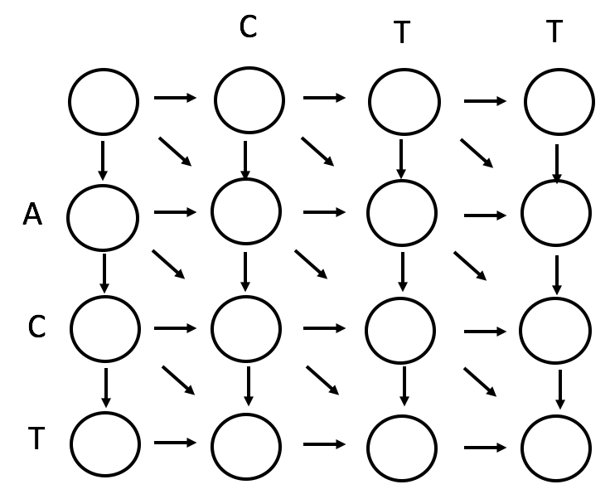
Dynamic Programming
We have an alignment graph
We have a scoring system
We’re still faced with the problem of having to score all possible paths in order to find the maximum
Scoring System for DNA: Match = +1 Mismatch = -1 Gap = -1
The solution can be obtained by applying an approach known as Dynamic Programming (we used this for HMMs!)

Slide 15
The Two Principles of Dynamic Programming
Take a complex problem and break it down into a collection of simpler sub-problems
Solve each sub-problem and store the answer in memory for later use

Slide 16
Applying Dynamic Programming to Alignment Graphs
Our complex problem = Find the optimal path that goes across the entire alignment graph
Simpler sub-problem = Find the optimal path to each individual node in the graph from its’ nearest neighbors
Keep track of the optimal path to each node and save that answer into memory

Slide 17
Filling Out the Alignment Graph
How does this actually work?
Scoring System for DNA: Match = +1 Mismatch = -1 Gap = -1
C
T
T
0
-1
-2
-3
A
-1
-1
-2
-3
C
-2
0
-1
-3
T
-3
-1
1
0

Slide 18
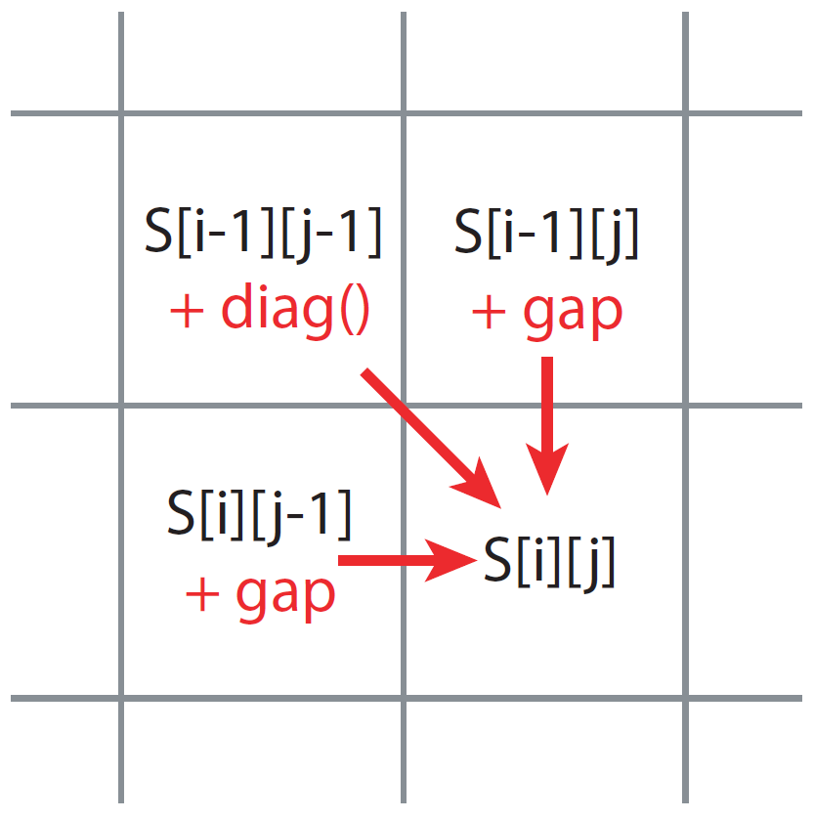
Filling Out the Alignment Graph

Slide 19
Filling Out the Alignment Graph
In order to find the optimal alignment all we have to do now is work our way backwards through the graph
Scoring System for DNA: Match = +1 Mismatch = -1 Gap = -1
C
T
T
0
-1
-2
-3
A
-1
-1
-2
-3
C
-2
0
-1
-3
T
-3
-1
1
0

Slide 20
Finding the Best Path Through Our Graph
In order to find the optimal alignment all we have to do now is work our way backwards through the graph
Scoring System for DNA: Match = +1 Mismatch = -1 Gap = -1
C
T
T
In this particular graph there are two possible optimal paths
For these two sequences there are two equally optimal alignments
What are the alignments?
0
-1
-2
-3
A
-1
-1
-2
-3
C
-2
0
-1
-3
T
-3
-1
1
0

Slide 21
Finding the Best Path Through Our Graph
In order to find the optimal alignment all we have to do now is work our way backwards through the graph
Scoring System for DNA: Match = +1 Mismatch = -1 Gap = -1
C
T
T
In this particular graph there are two possible optimal paths
For these two sequences there are two equally optimal alignments
What are the alignments?
0
-1
-2
-3
A
-1
-1
-2
-3
C
-2
0
-1
-3
-CTT
T
-3
AC-T
-1
1
0

Slide 22
Finding the Best Path Through Our Graph
In order to find the optimal alignment all we have to do now is work our way backwards through the graph
Scoring System for DNA: Match = +1 Mismatch = -1 Gap = -1
C
T
T
In this particular graph there are two possible optimal paths
For these two sequences there are two equally optimal alignments
What are the alignments?
0
-1
-2
-3
A
-1
-1
-2
-3
C
-2
0
-1
-3
-CTT
T
-3
ACT-
-1
1
0

Slide 23
Analyzing the Dynamic Programming Algorithm
Correctness? It can be proven that this approach always gives an optimal global alignment for two sequences
Speed? We no longer have to consider all possible paths ie. all possible alignments
We only need to calculate a best path to each node and then determine the traceback
~12 calculations need to be performed per node
if length of sequence 1 = N
if length of sequence 2 = M
# of nodes in the alignment graph will = N * M
Runtime for this algorithm when coded into a programming language ~ 12n*m
For computer runtime we ignore constants so runtime ~ n*m
Brute force alignment of two sequences of length 250 = ~1.17E149 calculations
Dynamic Programming algorithm with length 250 = 250² = 62,500 calculations

Slide 24
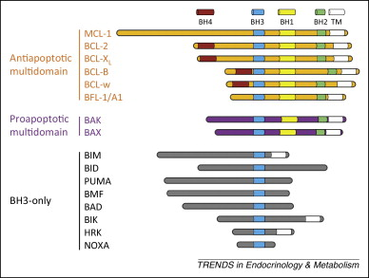
Local Alignments
Often we don’t actually want to perform a global pair-wise alignment
Often we are comparing distantly related sequences that contain sub-regions (functional domains) with high similarity
Local alignments can identify these domains
Trends in Endocrinology & Metabolism 2015 26, 165-175DOI: (10.1016/j.tem.2015.02.004)

Slide 25
Can we modify the global alignment algorithm so that it will find local alignments instead?
Anytime you would enter a negative score in the matrix, instead enter 0
What does this do?
Resets scoring locally
Don’t penalize the alignment in one section of the graph for a poor alignment that was occurring in another part of the graph
This is the essence of local alignment

Slide 26
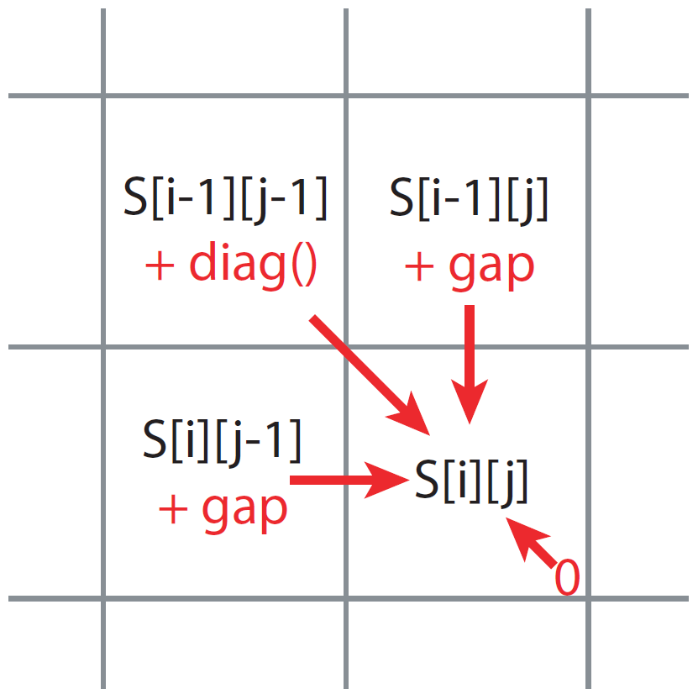
Local Alignments

Slide 27
Local Alignments
C
A
C
A
T
T
A
A
0
0
0
0
0
0
0
0
0
T
0
0
0
0
0
1
1
0
0
A
C
T
T
A
G

Slide 28
Local Alignments
C
A
C
A
T
T
A
A
0
0
0
0
0
0
0
0
0
T
0
0
0
0
0
1
1
0
0
A
0
0
1
0
1
0
0
1
1
C
0
0
0
2
1
0
0
0
0
T
0
0
0
1
1
2
1
0
0
T
0
0
0
0
0
2
3
2
1
A
0
0
1
0
1
1
2
4
3
G
0
0
0
0
0
0
1
3
3

Slide 29
Local Alignments
C
A
C
A
T
T
A
A
0
0
0
0
0
0
0
0
0
T
0
0
0
0
0
1
1
0
0
A
0
0
1
0
1
0
0
1
1
C
0
0
0
2
1
0
0
0
0
T
0
0
0
1
1
2
1
0
0
T
0
0
0
0
2
3
2
Look for the highest value in the graph
0
1
A
0
0
1
0
1
1
2
4
3
G
0
0
0
0
0
0
1
3
3

Slide 30
Local Alignments
C
A
C
A
T
T
A
A
0
0
0
0
0
0
0
0
0
T
0
0
0
0
0
1
1
0
0
A
0
0
1
0
1
0
0
1
1
C
0
0
0
2
1
0
0
0
0
T
0
0
0
1
1
2
1
0
0
T
0
0
0
0
2
3
2
Traceback until you hit zero
0
1
A
0
0
1
0
1
1
2
4
3
G
0
0
0
0
0
0
1
3
3

Slide 31
Local Alignments
C
A
C
A
T
T
A
A
0
0
0
0
0
0
0
0
0
T
0
0
0
0
0
1
1
0
0
A
0
0
1
0
1
0
0
1
1
C
0
0
0
2
1
0
0
0
0
T
0
0
0
1
1
2
1
0
0
T
0
0
0
0
0
2
3
2
1
0
0
1
0
ACATTA
A
1
1
2
4
3
Optimal local alignment:
AC-TTA
G
0
0
0
0
0
0
1
3
3

Slide 32
Analyzing the Local Alignment Algorithm
Correctness? It can be proven that this approach always gives an optimal local alignment for two sequences. Capable of finding multiple local alignments between two sequences as well
Speed? Runtime for the most part has not changed ~ 12n*m
Still roughly ~ n*m

Slide 33
Global alignment
Needleman, SB and CD Wunsch (1970) A general method applicable to the search for similarities in the amino acid sequences of two proteins., J. Mol. Biol 48: 443-553.
Local alignment
Smith, TF and MS Waterman (1981) Identification of common molecular subsequences., J. Mol Biol. 147: 195-197.

